Slide 1
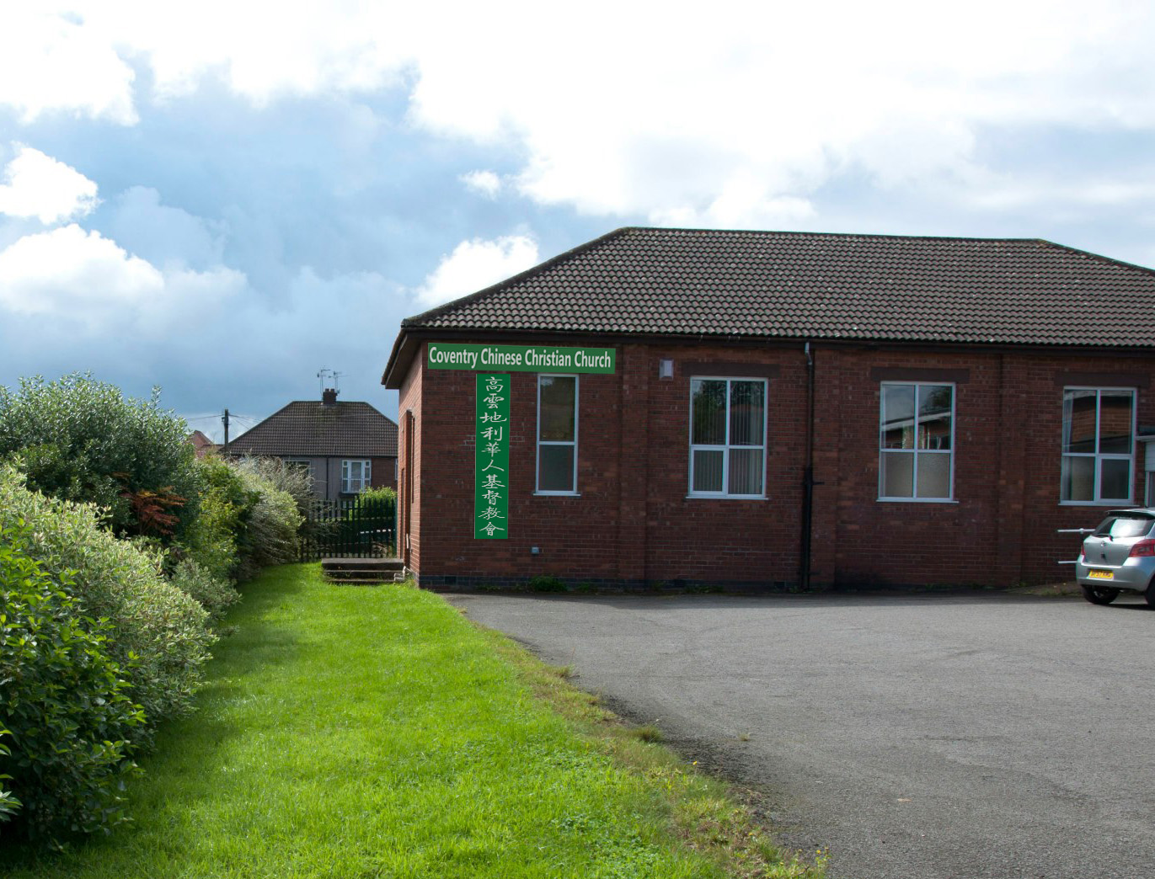
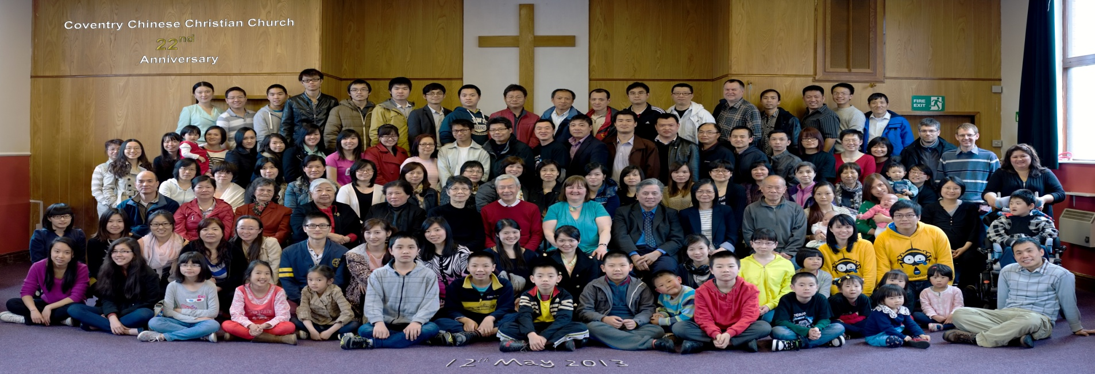
1 Cor林前13:9-13
婴孩 Babes：浸礼分享
Baptism sharing
韦焜墀牧师
Rev Edward Wei 131013
COVENTRY CHINESE CHRISTIAN CHURCH 高云地利华人基督教会

Slide 2
我不为
明天忧虑

Slide 3

回想童年时候，
不知道什么叫忧愁
随着年岁增多，
烦恼也跟着多
许多人忙忙碌碌地追求
却没有平安喜乐
再多忧虑
也改变 不了什么

Slide 4
你看天上飞鸟，
快乐自在地翱翔
你看野地的花，
如此美丽芬芳
慈爱的天父会养活它们
它们就不必烦忧
我们也当像它们 一样

Slide 5
把重担都卸给主，
我不为明天忧虑
天父知道我虽不好，
但他却仍垂顾我
他医治我的创伤，
他痛惜我的软弱
我知道我主掌管明天，我不为明天忧虑

Slide 6
回想童年时候，
不知道什么叫忧愁
随着年岁增多，
烦恼也跟着多
许多人忙忙碌碌地追求
却没有平安喜乐
再多忧虑
也改变 不了什么

Slide 7
你看天上飞鸟，
快乐自在地翱翔
你看野地的花，
如此美丽芬芳
慈爱的天父会养活它们
它们就不必烦忧
我们也当像它们 一样

Slide 8
把重担都卸给主，
我不为明天忧虑
天父知道我虽不好，
但他却仍垂顾我
他医治我的创伤，
他痛惜我的软弱
我知道我主掌管明天，我不为明天忧虑

Slide 9
把重担都卸给主，
我不为明天忧虑
天父知道我虽不好，
但他却仍垂顾我
他医治我的创伤，
他痛惜我的软弱
我知道我主掌管明天，我不为明天忧虑

Slide 10
我不為
明天憂慮

Slide 11
主题：孩子
Topic：Children
基督教很看重家庭和孩子
Christianity - focus on family and children

Slide 12
神的特别身份，就是父亲
父母亲和儿女这意念是
包含在神的形象和样式里面
one attribute of God is fatherhood；
the concept of parents and children is part of the image of God.

Slide 13
Eph弗3:14-15
因此我在父面前屈膝…15(天上地上的各家、都是从他得名）
For this reason I kneel before the Father [Greek: pater],
15 from whom his whole family [Gr: patria] in heaven and on earth derives its name.

Slide 14
神愿意我们与祂建立的关系
天父和儿女
the relationship
God wants with us:
Father and sons/daughters

Slide 15
Rom罗8:14-16
因为凡被神的灵引导的、都是神的儿子。15 你们所受的不是奴仆的心、仍旧害怕．
because those who are led by the Spirit of God are sons of God. 15 For you did not receive a spirit that makes you a slave again to fear,

Slide 16
所受的乃是儿子心、因此我们呼叫阿爸、父。16 圣灵与我们的心同证我们是神的儿女．
but you received the Spirit of sonship. And by him we cry, "Abba, Father.“The Spirit himself testifies with our spirit that we are God's children.

Slide 17
参主祷文：
我们在天上的父
cf the Lord’s prayer：
Our Father in heaven …。

Slide 18
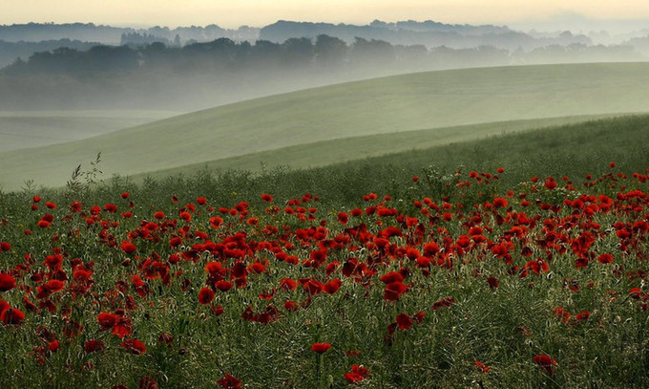
像小孩子
进神的国
Enter God’s kingdom
like a child

Slide 19
Mark 可10:13-16 14
耶稣...说、15 我实在告诉你们、凡要承受神国的、若不像小孩子 [路18:15婴儿]、断不能进去。
Jesus said to them, … 15 I tell you the truth, anyone who will not receive the kingdom of God like a little child [Luke 18:15 babes] will never enter it."

Slide 20
小孩子是很简单，
有需要不会逃避或隐藏,
且愿意相信关心他需要的人
Little children are simple.
They admit they have needs rather than hiding or running away,
and they are willing to trust those who can provide for the needs.

Slide 21
我们也有需要
We have needs…
Eph弗2:1-3
你们死在过犯罪恶之中、他叫你们活过来．
As for you, you were dead in your transgressions and sins,

Slide 22
那时、你们在其中行事为人随从今世的风俗、… 放纵肉体的私欲、随着肉体和心中所喜好的去行、。3 All of us also lived among them at one time, gratifying the cravings of our sinful nature and following its desires and thoughts

Slide 23
在过犯罪恶中，
In transgressions and sins
Ps诗90:10
我们一生的年日是七十岁．若是强壮可到八十岁．但其中所矜夸的、不过是劳苦愁烦．转眼成空、我们便如飞而去。The length of our days is seventy years, or eighty, if we have the strength; yet their span is but trouble and sorrow, for they quickly pass, and we fly away.

Slide 24
但是But：Eph弗2:4-6
然而神既有丰富的怜悯．因他爱我们的大爱、5 当我们死在过犯中的时候、便叫我们与基督一同活过来．But because of his great love for us, God, who is rich in mercy, 5 made us alive with Christ even when we were dead in transgressions--

Slide 25
（你们得救是本乎恩）6 他又叫我们与基督耶稣一同复活、一同坐在天上、
it is by grace you have been saved. 6 And God raised us up with Christ and seated us with him in the heavenly realms in Christ Jesus

Slide 26
我们是否愿意相信那关心我们,
也是唯一能关心我们的主耶稣?
Are we willing to trust
Jesus Christ,
the one and only one who cares for and can provide for us?

Slide 27
John约1:1-14
太初有道、道与神同在、道就是神。2 这道太初与神同在。In the beginning was the Word, and the Word was with God, and the Word was God. 2 He was with God in the beginning.

Slide 28
3 万物是借着他造的．凡被造的、没有一样不是借着他造的。4 生命在他里头．这生命就是人的光。3 Through him all things were made; without him nothing was made that has been made. 4 In him was life, and that life was the light of men.

Slide 29
9 那光是真光、照亮一切生在世上的人。9 The true light that gives light to every man was coming into the world.

Slide 30
14 道成了肉身、住在我们中间、充充满满的有恩典有真理。我们也见过他的荣光、正是父独生子的荣光。14 The Word became flesh and made his dwelling among us. We have seen his glory, the glory of the One and Only, who came from the Father, full of grace and truth.

Slide 31
12 凡接待他的、就是信他名的人、他就赐他们权柄、作神的儿女。12 Yet to all who received him, to those who believed in his name, he gave the right to become children of God--

Slide 32
13 这等人不是从血气生的、不是从情欲生的、也不是从人意生的、乃是从神生的。 13 children born not of natural descent, nor of human decision or a husband's will, but born of God.

Slide 33
像纔生的婴孩
爱慕奶一样。
Like newborn babies, crave spiritual milk。

Slide 34
1 Peter彼前2:2
就要爱慕那纯净的灵奶、像纔生的婴孩爱慕奶一样、叫你们因此渐长、以致得救．Like newborn babies, crave pure spiritual milk, so that by it you may grow up in your salvation,

Slide 35
信主重生以后，我们是新造的人，并追求成长；渴慕帮助我们成长的「灵奶」
When we trust Jesus and born again, we have become a new creation, and we seek to grow, craving the milk that groom us into maturity.

Slide 36
John约3:7-8
我说、你们必须重生、你不要以为希奇。You should not be surprised at my saying,
`You must be born again.'

Slide 37
8 风随着意思吹、你听见风的响声、却不晓得从那里来、往那里去．凡从圣灵生的、也是如此。 8 The wind blows wherever it pleases. You hear its sound, but you cannot tell where it comes from or where it is going. So it is with everyone born of the Spirit."

Slide 38
Acts徒2:40-47
彼得还用许多话作见证、劝勉他们说、你们当救自己脱离这弯曲的世代。With many other words he warned them; and he pleaded with them, "Save yourselves from this corrupt generation."

Slide 39
41 于是领受他话的人、就受了洗．那一天、门徒约添了三千人． Those who accepted his message were baptized, and about three thousand were added to their number that day.

Slide 40
都恒心遵守使徒的教训、
彼此交接、擘饼、祈祷。
They devoted themselves to the apostles' teaching and to the fellowship, to the breaking of bread and to prayer. ,,,

Slide 41
46 他们天天同心合意恒切的在殿里、且在家中擘饼、存着欢喜诚实的心用饭、Every day they continued to meet together in the temple courts. They broke bread in their homes and ate together with glad and sincere hearts

Slide 42
47 赞美神、得众民的喜爱。主将得救的人、天天加给他们。praising God and enjoying the favor of all the people. And the Lord added to their number daily those who were being saved.

Slide 43
Rom罗12:1-2
所以弟兄们、…将身体献上、当作活祭、是圣洁的、是神所喜悦的．你们如此事奉、乃是理所当然的。Therefore, I urge you, brothers, …to offer your bodies as living sacrifices, holy and pleasing to God--this is your spiritual act of worship.

Slide 44
2 不要效法这个世界．只要心意更新而变化、叫你们察验何为神的善良、纯全可喜悦的旨意。
Do not conform any longer to the pattern of this world, but be transformed by the renewing of your mind. Then you will be able to test and approve what God's will is--his good, pleasing and perfect will.

Slide 45
满有基督
长成的身量．
Attaining to the whole measure of the fullness of Christ.

Slide 46
Eph弗4:13
直等到我们众人在真道上同归于一、认识神的儿子、得以长大成人、满有基督长成的身量．
until we all reach unity in the faith and in the knowledge of the Son of God and become mature, attaining to the whole measure of the fullness of Christ.

Slide 47
一生的追求
lifelong pursuit
1 Cor林前13:9, 10, 12
我们现在所知道的有限、…10等那完全的来到、这有限的必归于无有了。 For we know in part, … 10 but when perfection comes, the imperfect disappears.

Slide 48
12我们如今仿佛对着镜子观看、模糊不清．〔如同猜谜〕到那时、就要面对面了．我如今所知道的有限．到那时就全知道、如同主知道我一样
Now we see but a poor reflection as in a mirror; then we shall see face to face. Now I know in part; then I shall know fully, even as I am fully known.

Slide 49
但是 However
1 Cor林前13:11
我作孩子的时候、话语像孩子、心思像孩子、意念像孩子．既成了人、就把孩子的事丢弃了。 When I was a child, I talked like a child, I thought like a child, I reasoned like a child. When I became a man, I put childish ways behind me.

Slide 50
但是 However
1 Cor林前3:1-3
2 我是用奶喂你们、没有用饭喂你们．那时你们不能吃、就是如今还是不能。 I gave you milk, not solid food, for you were not yet ready for it. Indeed, you are still not ready.

Slide 51
3 你们仍是属肉体的．因为在你们中间有嫉妒分争、这岂不是属乎肉体、照着世人的样子行么。 For since there is jealousy and quarreling among you, are you not worldly? Are you not acting like mere men?

Slide 52
Heb来5:13-14
凡只能吃奶的、都不熟练仁义的道理．因为他是婴孩。 Anyone who lives on milk, being still an infant, is not acquainted with the teaching about righteousness.

Slide 53
14 惟独长大成人的、纔能吃干粮、他们的心窍、习练得通达、就能分辨好歹了。 But solid food is for the mature, who by constant use have trained themselves to distinguish good from evil.

Slide 54
1 Cor林前14:20
弟兄们、在心志上不要作小孩子．然而在恶事上要作婴孩．在心志上总要作大人。 Brothers, stop thinking like children. In regard to evil be infants, but in your thinking be adults.

Slide 55
Jude犹20-21
亲爱的弟兄阿、你们却要在至圣的真道上造就自己、在圣灵里祷告、dear friends, build yourselves up in your most holy faith and pray in the Holy Spirit.

Slide 56
、21. 保守自己常在神的爱中、仰望我们主耶稣基督的怜悯、直到永生。Keep yourselves in God's love as you wait for the mercy of our Lord Jesus Christ to bring you to eternal life.

Slide 57
1 Cor林前13:13
如今常存的有信、有望、有爱、这三样、其中最大的是爱。 And now these three remain: faith, hope and love. But the greatest of these is love.

Slide 58
心意不断更新而变化，在
信心、盼望和爱中
不断成长。
Let our minds be continually renewed and transformed，
in faith, in hope and in love, growing unto maturity

Slide 59
2 Cor林后3:17-18
主就是那灵、主的灵在那里、那里就得以自由。Now the Lord is the Spirit, and where the Spirit of the Lord is, there is freedom.

Slide 60
18 我们众人既然敞着脸、得以看见主的荣光、好像从镜子里返照、就变成主的形状、荣上加荣、如同从主的灵变成的。
And we, who with unveiled faces all reflect the Lord's glory, are being transformed into his likeness with ever-increasing glory, which comes from the Lord, who is the Spirit.

Slide 61
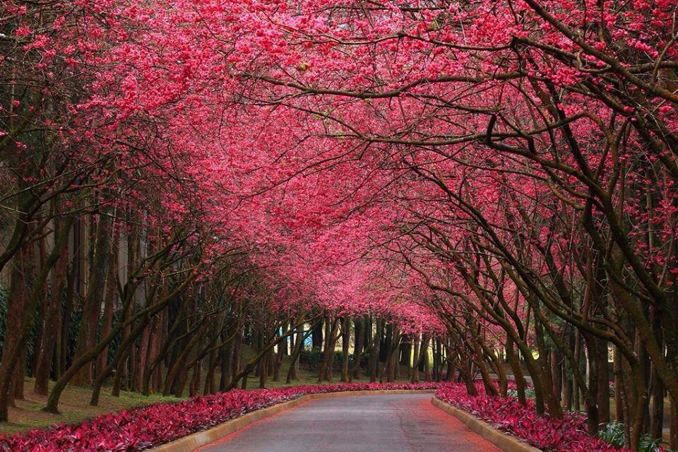
We fall down,
我放下

Slide 62
We fall down,
We lay our crowns
At the feet of Jesus
我放下
所有冠冕，
在耶稣的脚前，

Slide 63
The greatness of
Your Mercy and love
At the feet of Jesus
有宽容
怜悯和爱，
在耶稣的脚前。

Slide 64
We cry holy, holy, holy
We cry holy, holy, holy
We cry holy, holy, holy
Is the lamb
我高唱,圣洁,圣洁,圣洁,
我高唱,圣洁,圣洁,圣洁,
我高唱,圣洁,圣洁,圣洁,
神羔羊。

Slide 65
We fall down,
We lay our crowns
At the feet of Jesus
我放下
所有冠冕，
在耶稣的脚前，

Slide 66
The greatness of
Your Mercy and love
At the feet of Jesus
有宽容
怜悯和爱，
在耶稣的脚前。

Slide 67
We cry holy, holy, holy
We cry holy, holy, holy
We cry holy, holy, holy
Is the lamb
我高唱,圣洁,圣洁,圣洁,
我高唱,圣洁,圣洁,圣洁,
我高唱,圣洁,圣洁,圣洁,
神羔羊。

Slide 68
We cry holy, holy, holy
We cry holy, holy, holy
We cry holy, holy, holy
Is the lamb
我高唱,圣洁,圣洁,圣洁,
我高唱,圣洁,圣洁,圣洁,
我高唱,圣洁,圣洁,圣洁,
神羔羊。

Slide 69
We fall down,
我放下

