Slide 1



Baptismal Service
浸禮崇拜
貝爾法斯特華人基督教會
14
0427
韋焜墀牧師
Rev Edward Wei
web: ekcwei.co.uk

Slide 2

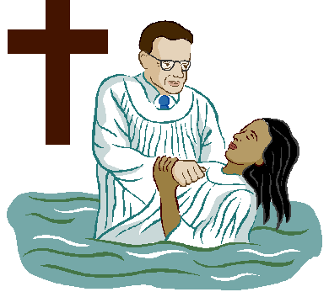
洗礼(浸礼)
Christian Baptism

Slide 3
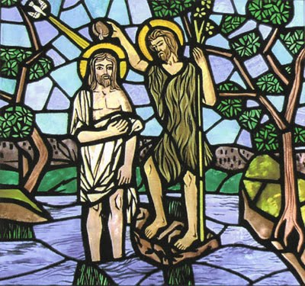
耶稣作先例
Initiated by Jesus

Slide 4
可Mark 1:9-11
那时、耶稣从加利利的拿撒勒来、在约但河里受了约翰的洗
At that time Jesus came from Nazareth in Galilee and was baptized by John in the Jordan.

Slide 5
他从水里一上来、就看见天裂开了、圣灵仿佛鸽子、降在他身上。又有声音从天上来说、你是我的爱子、我喜悦你。
As Jesus was coming up out of the water, he saw heaven being torn open and the Spirit descending on him like a dove. And a voice came from heaven: "You are my Son, whom I love; with you I am well pleased."

Slide 6

主耶稣的吩咐
Commanded by Christ

Slide 7
太Matt 28:19-20
所以你们要去、使万民作我的门徒、奉父子圣灵的名、给他们施洗．
Therefore go and make disciples of all nations, baptizing them in the name of the Father and of the Son and of the Holy Spirit,

Slide 8
凡我所吩咐你们的、都教训他们遵守我就常与你们同在、直到世界的末了。 and teaching them to obey everything I have commanded you. And surely I am with you always, to the very end of the age."

Slide 9
你是否接受耶稣为个人救主和主宰？
Do you accepted Jesus as personal Lord and Saviour?

Slide 10
宣布Announcement:
主耶稣, 你是我的救赎者, 你是我的主.
Dear Jesus,
You are my Saviour;
You are my Lord

Slide 11
今日你是单属于三一真神，所以撒但、邪灵并其他权势在你身上再没有主权。
You now belong to the Triune God. and hence the devil, evil spirits and any other principalities no longer have dominion over you.

Slide 12
宣布Announcement:
你是我的爱子（爱女）
You are my beloved son (daughter)

Slide 13

洗禮 (浸禮)
Baptism

Slide 14
羅馬書
Romans
6:3-11

Slide 15

可Mark 16:16
信而受洗的
必然得救．
Whoever believes and is baptized will be saved

Slide 16
徒Acts 2:38
你們各人要悔改、奉耶穌基督的名受洗、叫你們的罪得赦、就必領受所賜的聖靈．
"Repent and be baptized, every one of you, in the name of Jesus Christ for the forgiveness of your sins. And you will receive the gift of the Holy Spirit.

Slide 17
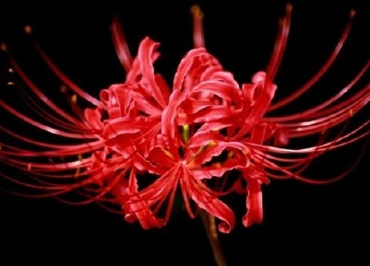
悔改
Repent
相信耶穌基督
Believe

Slide 18
悔改= 改變方向
Repent
= Turning

Slide 19

弗Eph2:1-3
你們死在過犯罪惡之中
As for you, you were dead in your transgressions and sins,

Slide 20
那時、你們在其中行事為人隨從今世的風俗、
in which you used to live when you followed the ways of this world

Slide 21
順服空中掌權者的首領、就是現今在悖逆之子心中運行的邪靈．
and of the ruler of the kingdom of the air, the spirit who is now at work in those who are disobedient.

Slide 22
我們從前也都在他們中間、放縱肉體的私慾、隨著肉體和心中所喜好的去行
All of us also lived among them at one time, gratifying the cravings of our sinful nature and following its desires and thoughts.

Slide 23

羅Romans 5:8-9
神的愛就在此向我們顯明了。
But God demonstrates his own love for us in this:

Slide 24
惟有基督在我們還作罪人的時候為我們死、現在我們既靠著他的血稱義、就更要藉著他免去神的忿怒。
While we were still sinners, Christ died for us. Since we have now been justified by his blood, how much more shall we be saved from God's wrath through him!

Slide 25
林後2Cor5:21
神使那無罪的、替我們成為罪．好叫我們在他裡面成為神的義。
God made him who had no sin to be sin for us, so that in him we might become the righteousness of God.

Slide 26

洗禮
Baptism

Slide 27
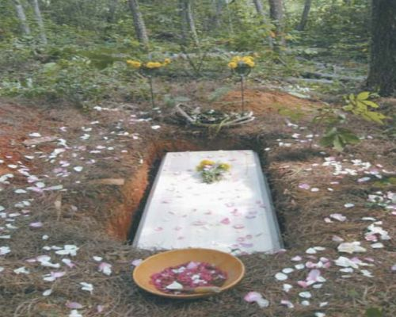
洗禮 Baptism

Slide 28
羅Rom6:4, 6
所以我們藉著洗禮歸入死、和他一同埋葬．…因為知道我們的舊人、和他同釘十字架、
We were therefore buried with him through baptism into death …
For we know that our old self was crucified with him

Slide 29
羅Rom6:8
我們若是與基督同死、就信必與他同活．
Now if we died with Christ, we believe that we will also live with him.

Slide 30
約11:25-26
耶穌對他說、
復活在我、
生命也在我．
Jesus said to her,
"I am the resurrection and the life

Slide 31
信我的人、雖然死了、也必復活． 凡活著信我的人、必永遠不死。
He who believes in me will live, even though he dies;
and whoever lives and believes in me will never die.

Slide 32
林後2Cor4:16
所以我們不喪膽．
外體雖然毀壞、內心卻一天新似一天。
Therefore we do not lose heart. Though outwardly we are wasting away, yet inwardly we are being renewed day by day.

Slide 33
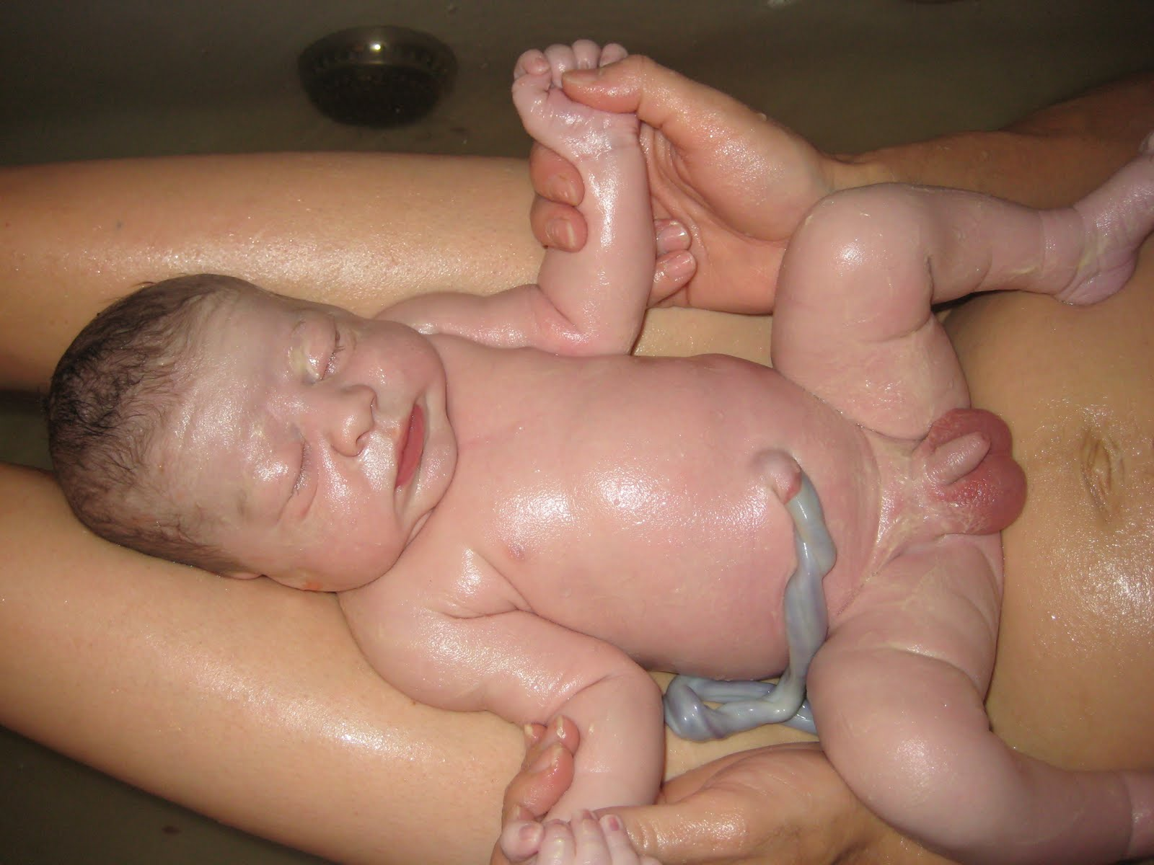
洗禮 Baptism

Slide 34
林後2Cor5:17
若有人在基督裡、
他就是新造的人．
舊事已過、都變成新的了。
Therefore, if anyone is in Christ, he is a new creation; the old has gone, the new has come!

Slide 35

約John1:12-13
凡接待他的、就是信他名的人、他就賜他們權柄、
作神的兒女。
Yet to all who received him, to those who believed in his name, he gave the right to become children of God -

Slide 36
這等人不是從血氣生的、
不是從情慾生的、也不是從人意生的、乃是從神生的。
children born not of natural descent, nor of human decision or a husband's will, but
born of God.

Slide 37
西Col1:22
但如今他藉著基督的肉身受死、叫你們與自己和好、都成了聖潔、沒有瑕疵、無可責備、把你們引到自己面前。 But now he has reconciled you by Christ's physical body through death to present you holy in his sight, without blemish and free from accusation--

Slide 38

新生命
新的開始
New Life
New Beginning

Slide 39
加Gal2:20
我已經與基督同釘十架．現在活著的、不再是我、
I have been crucified with Christ and I no longer live,

Slide 40
乃是基督在我裡面活著．並且我如今在肉身活著、是因信神的兒子而活、
他是愛我、為我捨己。
but Christ lives in me. The life I live in the body, I live by faith in the Son of God, who loved me and gave himself for me.

Slide 41
羅Rom6:10-11
他死是向罪死了、只有一次．他活是向神活著。
The death he died, he died to sin once for all; but the life he lives, he lives to God

Slide 42
這樣、你們向罪也當看自己是死的．向神在基督耶穌裡、卻當看自己是活的。 In the same way, count yourselves dead to sin but alive to God in Christ Jesus.

Slide 43
羅Rom12:2

Slide 44
不要效法這個世界．
只要心意更新而變化、
Do not conform any longer to the pattern of this world, but be transformed by the renewing of your mind.

Slide 45
叫你們察驗何為神的善良、純全可喜悅的旨意。Then you will be able to test and approve what God's will is--his good, pleasing and perfect will.

Slide 46
他活是向神活著。
這樣、你們向神在基督耶穌裡、卻當看自己是活的。 the life he lives, he lives to God.
In the same way, count yourselves alive to God in Christ Jesus.

Slide 47


Slide 48


Slide 49


Slide 50


Slide 51
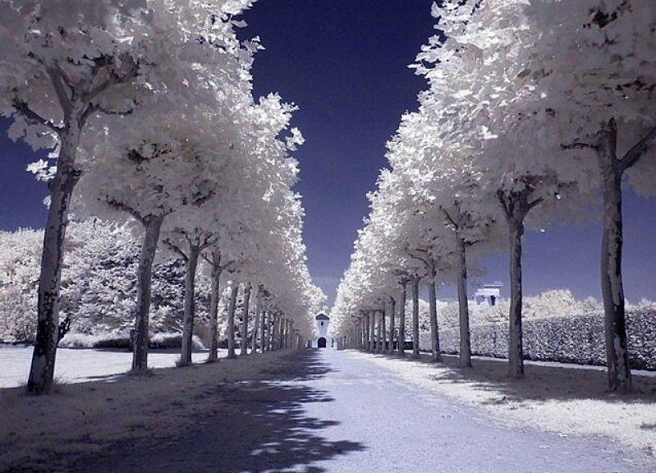

Slide 52


Slide 53
Take my hand Precious Lord
亲爱主牵我手

Slide 54


Take my hand
Precious Lord
亲爱主牵我手
词曲：Thomas A. Dorsey

Slide 55
亲爱主 牵我手
建立我 领我走
我疲倦 我软弱 我苦愁
Precious Lord, take my hand
Lead me on, let me stand
I am tired, I am weak, I am worn

Slide 56
经风暴 过黑夜
求领我进光明
亲爱主 牵我手 到天庭
Through the storm, through the night
Lead me on to the light
Take my hand precious Lord, lead me home

Slide 57

我道路 虽凄凉
主临近 慰忧伤
我在世快打完美好仗
When my way grows drear
Precious Lord linger near
When my life is almost gone

Slide 58
听我求 听我祷
牵我手 防跌倒
亲爱主 牵我手 常引导
Hear my cry, hear my call
Hold my hand lest I fall
Take my hand precious Lord, lead me home

Slide 59
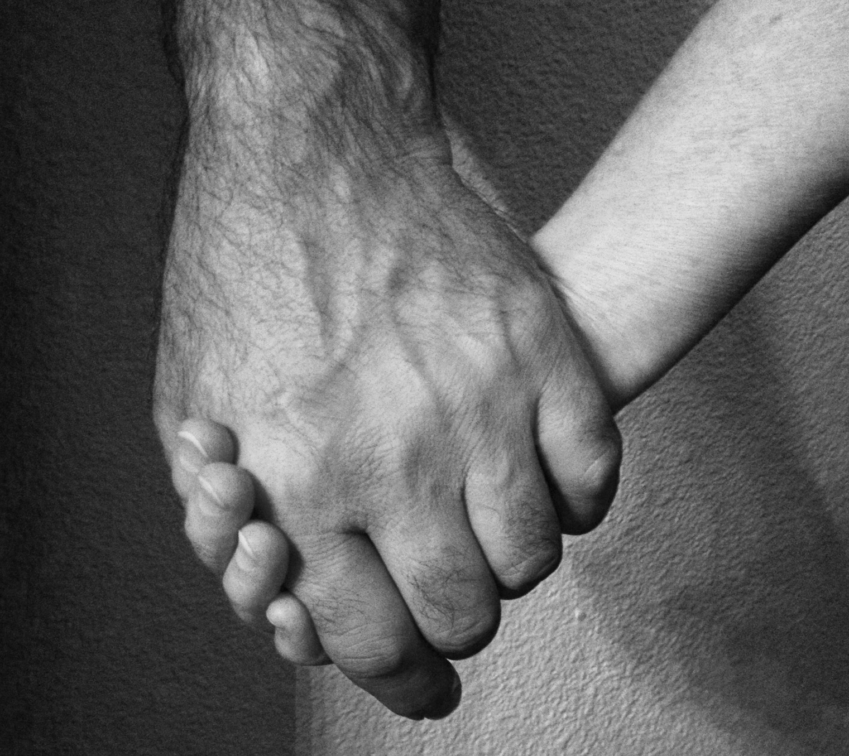

Slide 60

听我求 听我祷
牵我手 防跌倒
亲爱主 牵我手 常引导
Hear my cry, hear my call
Hold my hand lest I fall
Take my hand precious Lord, lead me home

Slide 61
Take my hand
Precious Lord
亲爱主牵我手

Slide 62
Take my hand
Precious Lord
亲爱主牵我手
词曲：Thomas A. Dorsey

Slide 63
亲爱主 牵我手
建立我 领我走
我疲倦 我软弱 我苦愁
Precious Lord, take my hand
Lead me on, let me stand
I am tired, I am weak, I am worn

Slide 64
经风暴 过黑夜
求领我进光明
亲爱主 牵我手 到天庭
Through the storm, through the night
Lead me on to the light
Take my hand precious Lord, lead me home

Slide 65
我道路 虽凄凉
主临近 慰忧伤
我在世快打完美好仗
When my way grows drear
Precious Lord linger near
When my life is almost gone

Slide 66
听我求 听我祷
牵我手 防跌倒
亲爱主 牵我手 常引导
Hear my cry, hear my call
Hold my hand lest I fall
Take my hand precious Lord, lead me home

Slide 68
听我求 听我祷
牵我手 防跌倒
亲爱主 牵我手 常引导
Hear my cry, hear my call
Hold my hand lest I fall
Take my hand precious Lord, lead me home

Slide 69
Take my hand
Precious Lord
亲爱主牵我手

