Slide 1
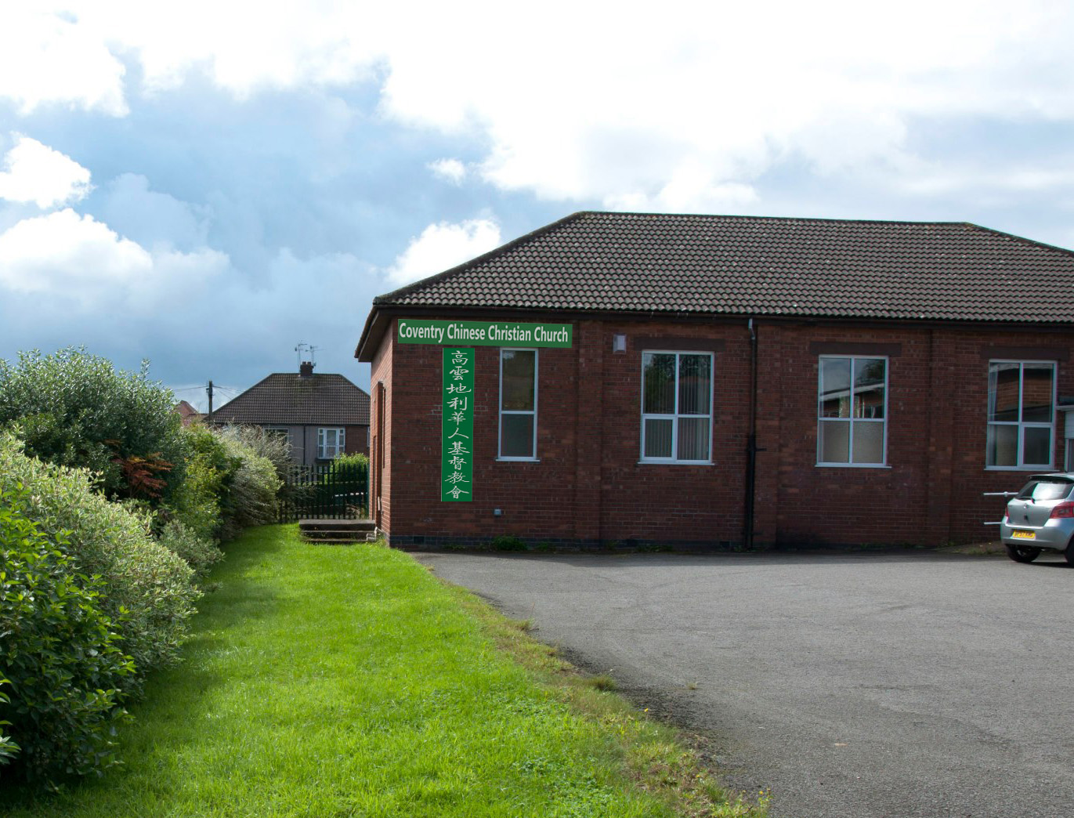
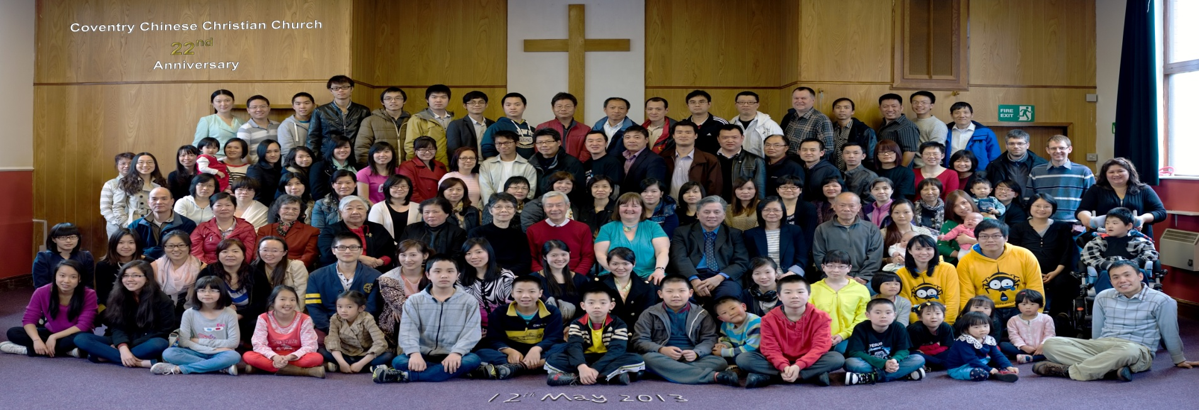
践行爱与真理
Love and Truth in action
(弗Eph 4:17-5:2)
韦焜墀牧师
141109
COVENTRY CHINESE CHRISTIAN CHURCH 高云地利华人基督教会

Slide 2
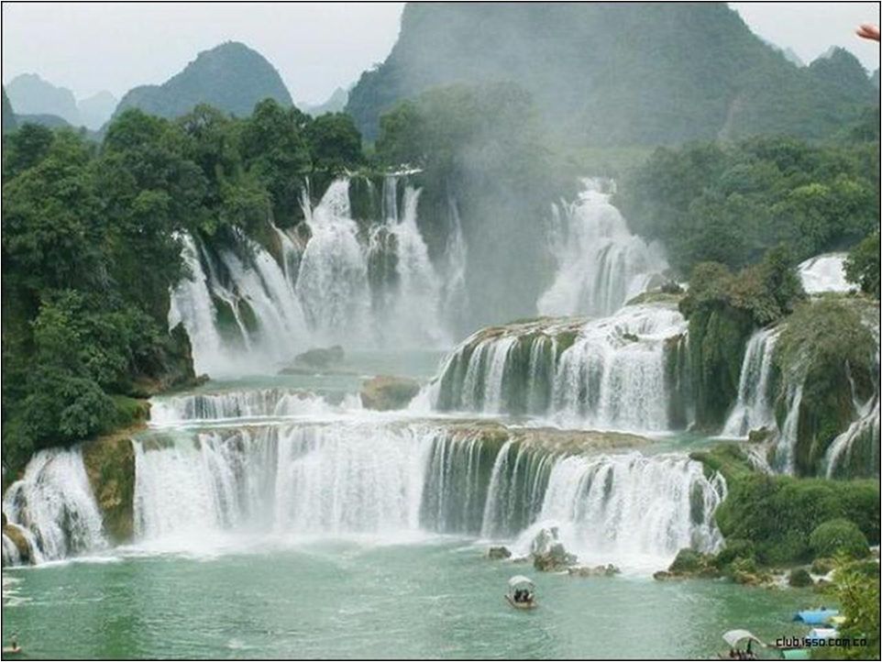
信而受洗
Believe and be baptised

Slide 3
好像一個錢幣的兩面
Like two sides of a coin;
represent the same incident; baptism is
the outward declaration of
an inward belief.

Slide 4

可16:16
信而受洗的必然得救．
Mark 16:16
Whoever believes and is baptized will be saved,

Slide 5
徒 Acts 2:38
彼得说、你们各人要悔改、奉耶稣基督的名受洗、叫你们的罪得赦、就必领受所赐的圣灵．
Peter replied, "Repent and be baptized, every one of you, in the name of Jesus Christ for the forgiveness of your sins. And you will receive the gift of the Holy Spirit."

Slide 6
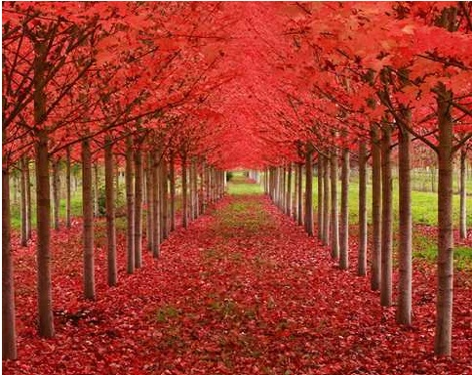
新生命
New life

Slide 7
林後5:17
若有人在基督里、他就是新造的人．旧事已过、都变成新的了。
2 Cor 5:17
Therefore, if anyone is in Christ, he is a new creation; the old has gone, the new has come!

Slide 8
罗 Rom 6:4
所以我们藉著洗礼归入死、和他一同埋葬．原是叫我们一举一动有新生的样式、像基督藉著父的荣耀、从死里复活一样
We were therefore buried with him through baptism into death in order that, just as Christ was raised from the dead through the glory of the Father, we too may live a new life.

Slide 9


Slide 10

以弗所书 Ephesians
4:17-5:2

Slide 11
弗 5:1所以你们该效法神、好像蒙慈爱的儿女一样．
Eph 5:1 Be imitators of God, therefore, as dearly loved children

Slide 12
2也要凭爱心行事、正如基督爱我们、为我们捨了自己、当作馨香的供物和祭物献与神。
2 and live a life of love, just as Christ loved us and gave himself up for us as a fragrant offering and sacrifice to God.

Slide 13
弗Eph 5:1-2
所以你们该效法神、好像蒙慈爱的儿女一样．也要凭爱心行事、正如基督爱我们、为我们捨了自己、当作馨香的供物和祭物献与神。
Be imitators of God, therefore, as dearly loved children and live a life of love, just as Christ loved us and gave himself up for us as a fragrant offering and sacrifice to God.

Slide 14
蒙慈爱的儿女
God’s dearly loved children

Slide 15
罗 Rom 8:15-16
你們所受的不是奴僕的心、仍舊害怕．所受的乃是兒子心、因此我們呼叫阿爸、父。
For you did not receive a spirit that makes you a slave again to fear, but you received the Spirit of sonship. And by him we cry, ""Abba," Father.”

Slide 16
聖靈與我們的心同證
我們是神的兒女．
The Spirit himself testifies with our spirit that we are God's children.

Slide 17
约壹 1 John 4:17-18
这样、爱在我们里面得以完全、
我们就可以在审判的日子、
坦然无惧．
In this way, love is made complete among us so that we will have confidence on the day of judgment, because in this world we are like him.

Slide 18
18 爱里没有惧怕．爱既完全、就把惧怕除去．因为惧怕里含著刑罚．惧怕的人在爱里未得完全。
18 There is no fear in love.
But perfect love drives out fear, because fear has to do with punishment. The one who fears is not made perfect in love.

Slide 19
弗Eph 5:1-2
所以你们该效法神、好像蒙慈爱的儿女一样．也要凭爱心行事、正如基督爱我们、为我们捨了自己、当作馨香的供物和祭物献与神。
Be imitators of God, therefore, as dearly loved children and live a life of love, just as Christ loved us and gave himself up for us as a fragrant offering and sacrifice to God.

Slide 20
弗4:17所以我说、且在主里确实的说、你们行事、不要再像外邦人存虚妄的心行事．
Eph 17 So I tell you this, and insist on it in the Lord, that you must no longer live as the Gentiles do, in the futility of their thinking.

Slide 21
18他们心地昏昧、与神所赐的生命隔绝了、都因自己无知、心里刚硬．
18 They are darkened in their understanding and separated from the life of God because of the ignorance that is in them due to the hardening of their hearts.

Slide 22
19良心既然丧尽、就放纵私慾、贪行种种的污秽。
19 Having lost all sensitivity, they have given themselves over to sensuality so as to indulge in every kind of impurity, with a continual lust for more.

Slide 23
效法神
Be imitators of God

Slide 25
罗Rom 6:6
因为知道我们的旧人、和他同钉十字架、使罪身灭绝、叫我们不再作罪的奴僕．
For we know that our old self was crucified with him so that the body of sin might be done away with, that we should no longer be slaves to sin

Slide 26
西Col 3:9-12
因你们已经脱去旧人、和旧人的行为、... 12 所以你们既是 神的选民、圣洁蒙爱的人、…
since you have taken off your old self with its practices ... 12 Therefore, as God's chosen people, holy and dearly loved, ..

Slide 27
西Col 3:9-12
因你们已经脱去旧人、和旧人的行为、... 12 所以你们既是 神的选民、圣洁蒙爱的人、…
since you have taken off your old self with its practices ... 12 Therefore, as God's chosen people, holy and dearly loved, ..

Slide 28
弗Eph 5:1-2
所以你们该效法神、好像蒙慈爱的儿女一样．也要凭爱心行事、正如基督爱我们、为我们捨了自己、当作馨香的供物、和祭物、献与神。Be imitators of God, therefore, as dearly loved children and live a life of love, just as Christ loved us and gave himself up for us as a fragrant offering and sacrifice to God.

Slide 29
弗4:20你们学了基督、却不是这样．
Eph 4:20 You, however, did not come to know Christ that way.

Slide 30
21如果你们听过他的道、领了他的教、学了他的真理、
21 Surely you heard of him and were taught in him in accordance with the truth that is in Jesus.

Slide 31
22就要脱去你们从前行为上的旧人．这旧人是因私慾的迷惑、渐渐变坏的．
22 You were taught, with regard to your former way of life, to put off your old self, which is being corrupted by its deceitful desires;

Slide 32
23又要将你们的心志
改换一新．
23 to be made new in the attitude of your minds;

Slide 33
24并且穿上新人．这新人是照著神的形像造的、有真理的仁义、和圣洁。
24 and to put on the new self, created to be like God in true righteousness and holiness.

Slide 34
正如基督
Just as Christ

Slide 35
加 Gal 2:20
我已經與基督同釘十架．現在活著的不再是我、乃是基督在我裡面活著．並且我如今在肉身活著是因信 神的兒子而活、他是愛我為我捨己。
I have been crucified with Christ and I no longer live, but Christ lives in me. The life I live in the body, I live by faith in the Son of God, who loved me and gave himself for me.

Slide 36
弗Eph 5:1-2
所以你们该效法神、好像蒙慈爱的儿女一样．也要凭爱心行事、正如基督爱我们、为我们捨了自己、当作馨香的供物、和祭物、献与神。Be imitators of God, therefore, as dearly loved children and live a life of love, just as Christ loved us and gave himself up for us as a fragrant offering and sacrifice to God.

Slide 37
凭爱心行事J
A life of Love
(爱的一生)

Slide 38
弗4:25所以你们要弃绝谎言、各人与邻舍说实话．因为我们是互相为肢体。
Eph 4:25 Therefore each of you must put off falsehood and speak truthfully to his neighbor, for we are all members of one body.

Slide 39
26生气却不要犯罪．不可含怒到日落．
26 "In your anger do not sin": Do not let the sun go down while you are still angry,
27也不可给魔鬼留地步。
27 and do not give the devil a foothold.

Slide 40
28从前偷窃的、不要再偷．总要劳力、亲手作正经事、就可有馀、分给那缺少的人。
28 He who has been stealing must steal no longer, but must work, doing something useful with his own hands, that he may have something to share with those in need.

Slide 41
29污秽的言语、一句不可出口、只要随事说造就人的好话、叫听见的人得益处。
29 Do not let any unwholesome talk come out of your mouths, but only what is helpful for building others up according to their needs, that it may benefit those who listen.

Slide 42
30不要叫神的圣灵担忧．你们原是受了他的印记、等候得赎的日子来到。
30 And do not grieve the Holy Spirit of God, with whom you were sealed for the day of redemption.

Slide 43
31一切苦毒、恼恨、忿怒、嚷闹、毁谤、并一切恶毒、〔或作阴毒〕都当从你们中间除掉．
31 Get rid of all bitterness, rage and anger, brawling and slander, along with every form of malice.

Slide 44
32并要以恩慈相待、存怜悯的心、彼此饶恕、正如神在基督里饶恕了你们一样。
32 Be kind and compassionate to one another, forgiving each other, just as in Christ God forgave you.

Slide 45
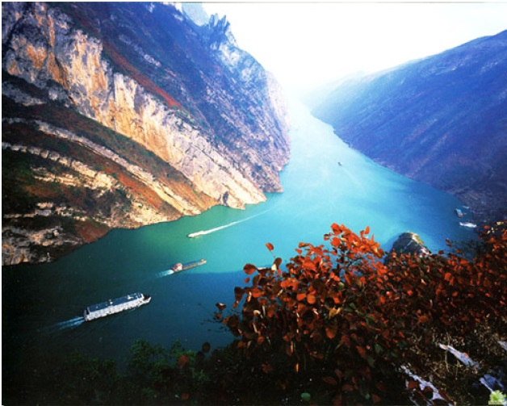
新的开始
New Beginning

Slide 46
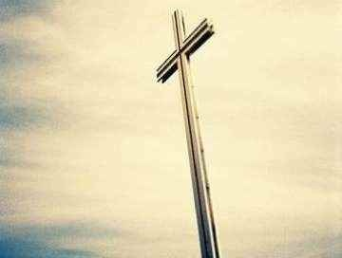
約 John 4:14
人若喝我所賜的水就永遠不渴．我所賜的水、要在他裡頭成為泉源、直湧到永生。
but whoever drinks the water I give him will never thirst. Indeed, the water I give him will become in him a spring of water welling up to eternal life.

Slide 47
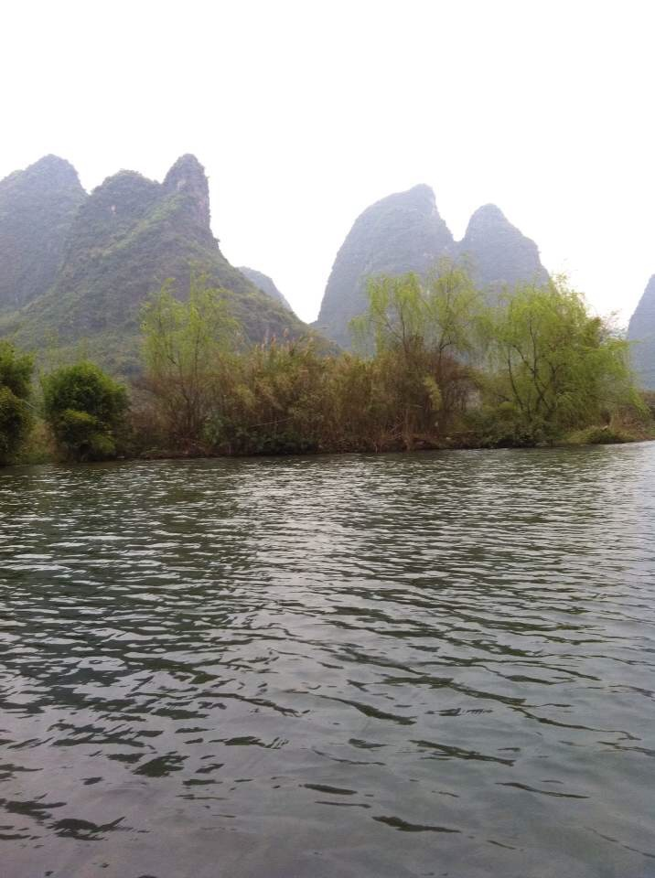
住在你里面

Slide 48
在乾旱无水之地我渴慕你，
在旷野无人之处我寻求你，
In a dry and weary land, I long for You
In a lonely wilderness, I search for You

Slide 49
得救在乎归回安息，
得力在乎平静平稳，
我等候你，
如鹰展翅上腾。
I will rest in Your salvation
In quietness I trust You
I wait for You to lift me on Your wings

Slide 50
在乾旱无水之地我渴慕你，
在旷野无人之处我寻求你，
In a dry and weary land, I long for You
In a lonely wilderness, I search for You

Slide 51
得救在乎归回安息，
得力在乎平静平稳，
我等候你，
如鹰展翅上腾。
I will rest in Your salvation
In quietness I trust You
I wait for You to lift me on Your wings

Slide 52

住在你里面，
住在你里面，
如同枝子与葡萄树紧紧相连，
Abiding in You, abiding in You
You are the vine and I'm the branch, I am in You

Slide 53
住在你里面，
住在你里面，
领受生命活水泉源永不枯竭。
Abiding in You, abiding in You
Your living water flows in me forevermore

Slide 54
住在你里面，
住在你里面，
如同枝子与葡萄树紧紧相连，
Abiding in You, abiding in You
You are the vine and I'm the branch, I am in You

Slide 55
住在你里面，
住在你里面，
领受生命活水泉源永不枯竭。
Abiding in You, abiding in You
Your living water flows in me forevermore

Slide 56
住在你里面，
住在你里面，
领受生命活水泉源永不枯竭
Abiding in You, abiding in You
Your living water flows in me forevermore

Slide 57
住在你里面

